Slide 1
ONLINE ORGAN DONATION AND DONOR FINDER
SUBMITTED BY
MIDHUN KRISHNA
RMCA-B
ROLL NO: 8

Slide 2
ABSTRACT
Organ donation is the donation of biological tissue or an organ of the human body, from a living or dead person to a living recipient in need of a transplantation. Transplantable organs and tissues are removed in a surgical procedure following a determination, based on the donor's medical and social history, of which are suitable for transplantation. Online Organ Donation & Donor Finder will help user to get organ donor and doctors. This system has four entities Admin ,User ,Doctor & Hospital. Admin can login using credentials. Admin can view & delete donors . Admin can view list of donations and user list. User can view and update their profile. User can request or donate Organs. User can also view the assigned doctor and donor. Doctors can login using credentials. Doctors can view user requests and manage donations. Hospitals can add doctors and view patient lists. Hospitals can message admins for urgent need of organs

Slide 3
EXISTING SYSTEM
Organ transplantation involves a complex, collaborative set of interactions among patients, family members, healthcare professionals and organ procurement. Currently, the way in which the procurement phase tasks are performed is still largely no automated and non-coordinated

Slide 4
DRAWBACKS OF EXISTING SYSTEM
• Medical experts have to consider one by one all the possible receivers and evaluate the matching with weak supports to process large amount of data.
• Information is usually not stored a in compact, re-usable way, therefore the coordination between medical experts and surgeons has to pass through telephone and facsimile.
• Finding the best route involves looking up several timetables of means of transport (such as trains or planes) and making spatial and temporal reasoning to provide the most efficient solution.
• Scheduling the medical teams involves looking up the timetables of operating theatres and medical personnel to find solutions which are available at the required times.

Slide 5
PROPOSED SYSTEM
The Proposed system is helpful to simplify and automate the process of searching the organ in case of emergency and maintaining the records of organ donors,recipients and the hospital details. Using this organ seeker can search for organ donors and admin cancommunicate with seeker and donors

Slide 6
PROPOSED SYSTEM
The system is very simple in design and to implement. The system requires very low system resources, and the system will work in almost all configurations. It has got following features:
➢Better security: - For data to remain secure measures must be taken to prevent unauthorized access. Security means that data are protected from various forms of destruction. The system security problem can be divided into four related issues: security, integrity, privacy and confidentiality. Username and password requirement to sign in ensuressecurity.It will also provide data security as we are using the secured databasesfor maintaining the documents.
➢Ensure data accuracy: - The proposed system eliminates the manual errors while entering the details of the users during the registration.
➢Better service: - The product will avoid the burden of hard copy storage. We can also conserve the time and human resources for doing the same task. The data can be maintained for longer period with no loss of data

Slide 7
MODULES
USER Module
ADMIN Module
HOSPITAL Module
DCOTOR Module

Slide 8
USER MODULE
User Registration
Login
Add Personal Details
Add Organ to Donate
Change password
Logout

Slide 9
ADMIN MODULE
Login
View Donor List
View Organ Details of Donors
View Patient Details
View/Check Queries requested by hospital
Search Donor via bloodgroup or Organ
Change password
Logout

Slide 10
HOSPITAL Module
Register
Login
Add doctor
View Patient Details
Delete Patient Details
View Donor Details
Message Admin for Urgent Request for organs
Search donor via Bloodgroup or Organ
Change password
Logout

Slide 11
DOCTOR MODULE
Registration
Login
Add Patient
View Patient Details
Delete Patient Details
View Donor Details
Change password
Logout

Slide 12
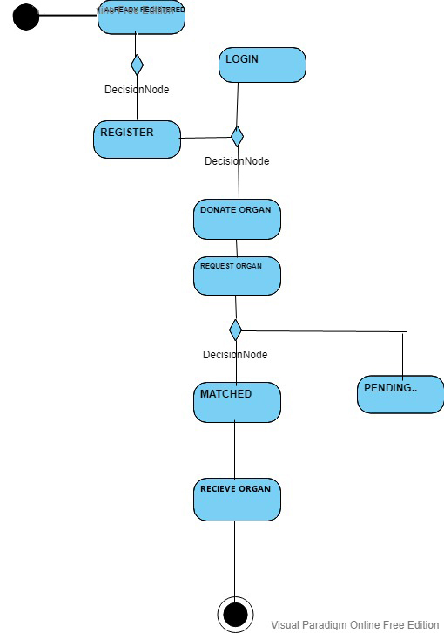
UML DIAGRAMS-ACTVITY DIAGRAM

Slide 13
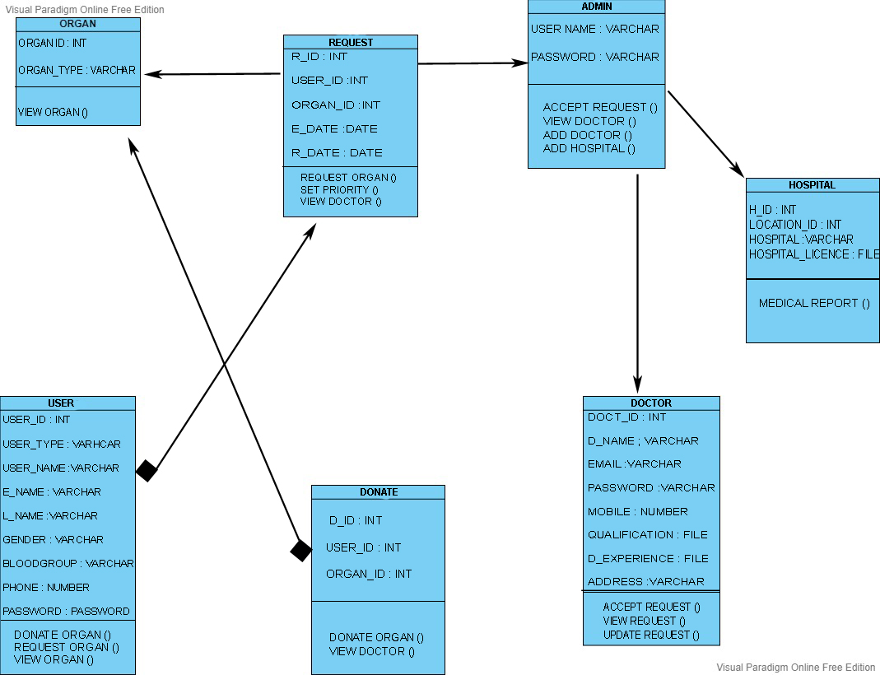
CLASS DIAGRAM

Slide 14
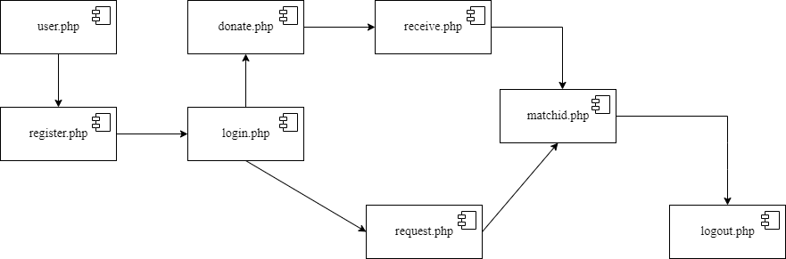
COMPONENT DIAGRAM

Slide 15
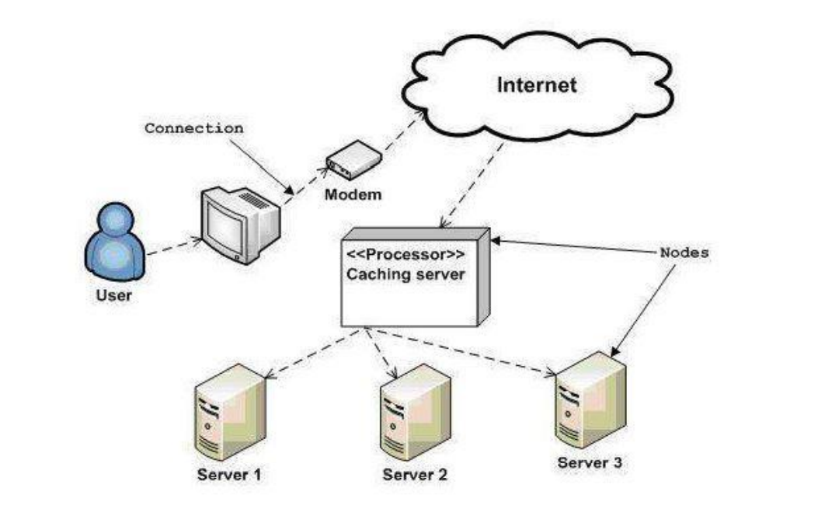
DEPLOYMENT DIAGRAM

Slide 16
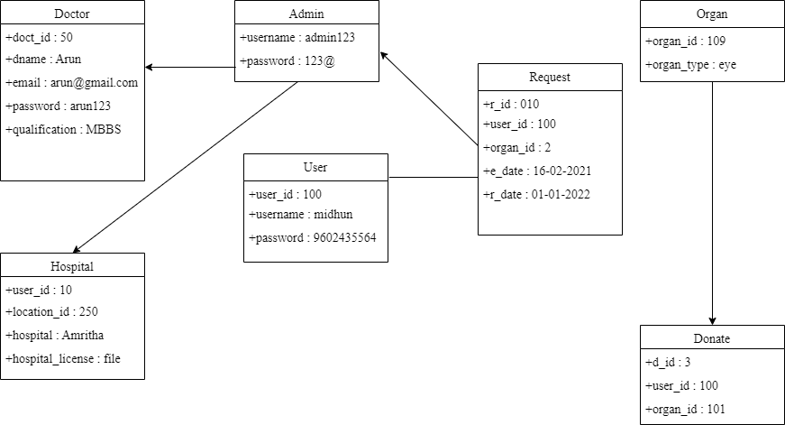
OBJECT DIAGRAM

Slide 17
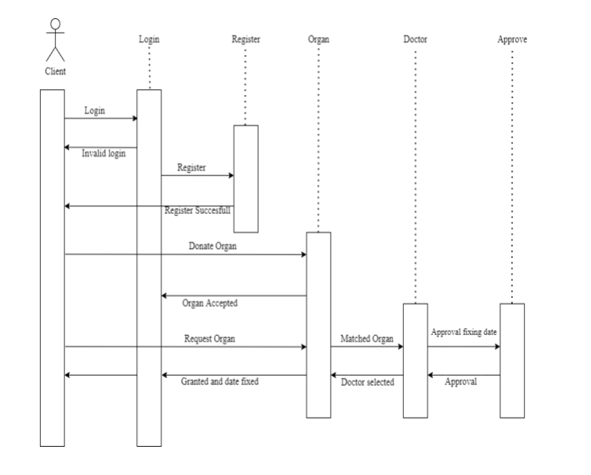
SEQUENCE DIAGRAM

Slide 18
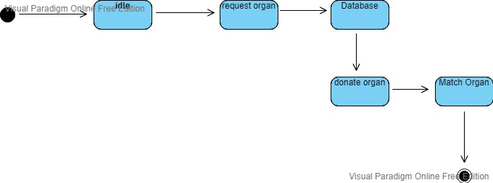
STATE CHART DESIGN

Slide 19
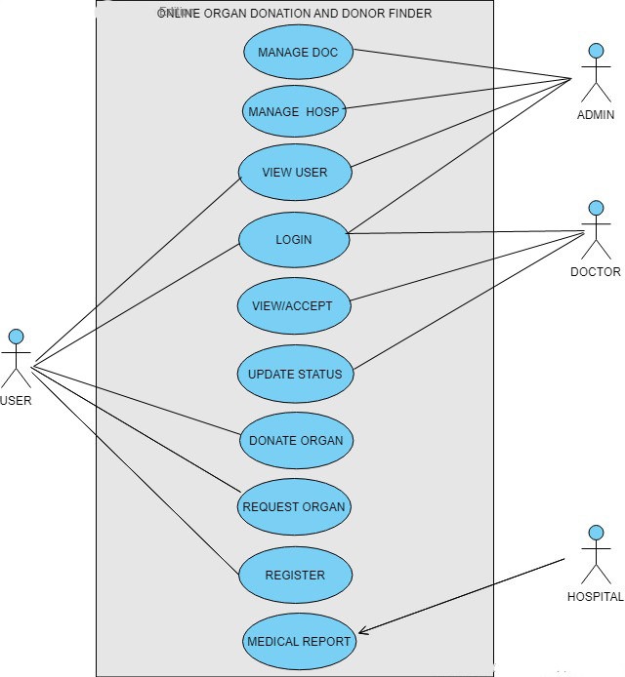
USECASE DIAGRAM

Slide 20
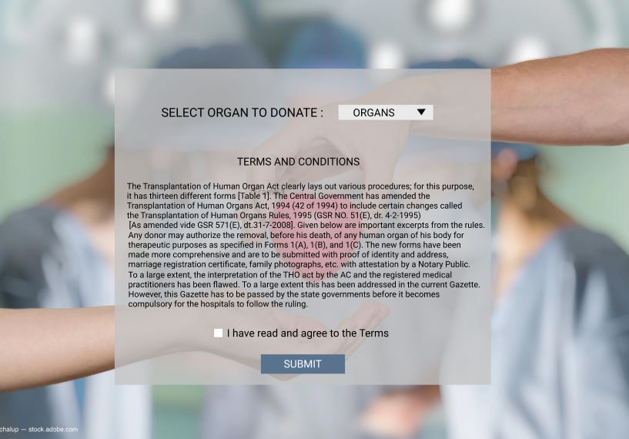
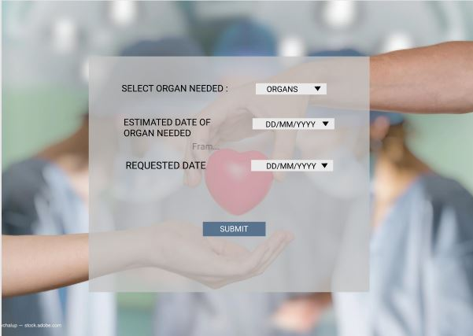
FIGMA

Slide 21
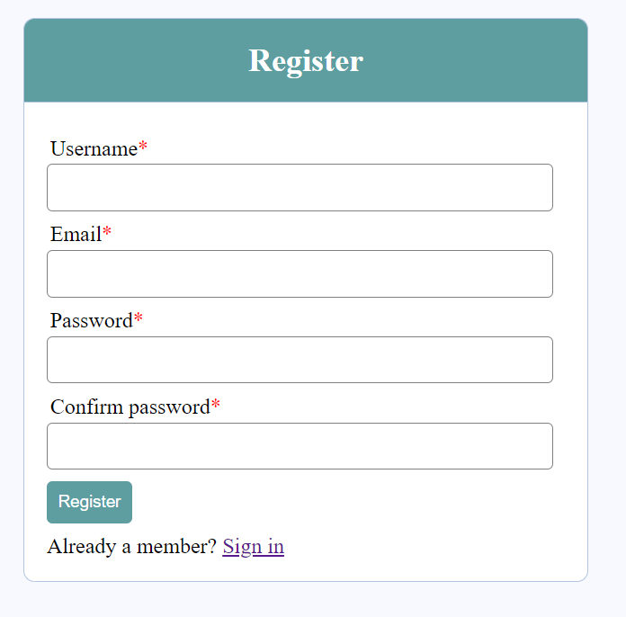
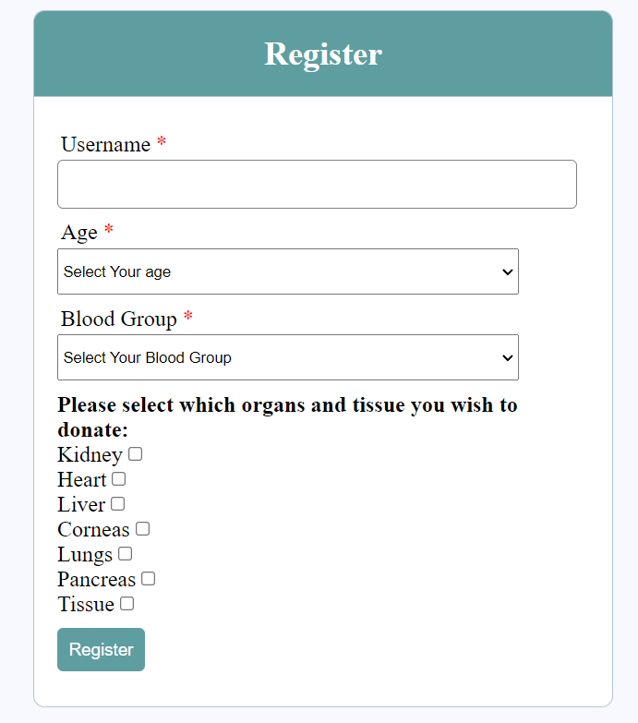

Slide 22
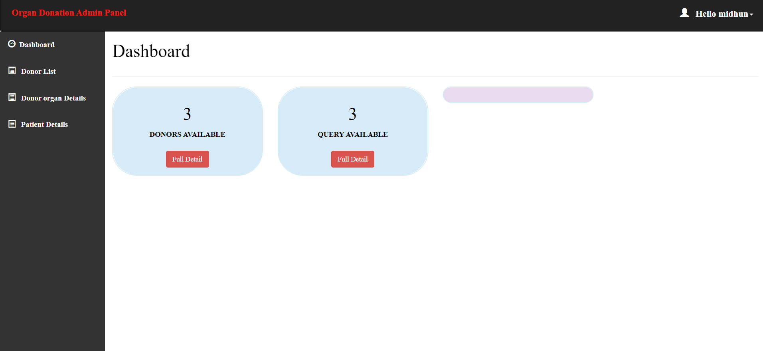
ADMIN HOME PAGE

Slide 23
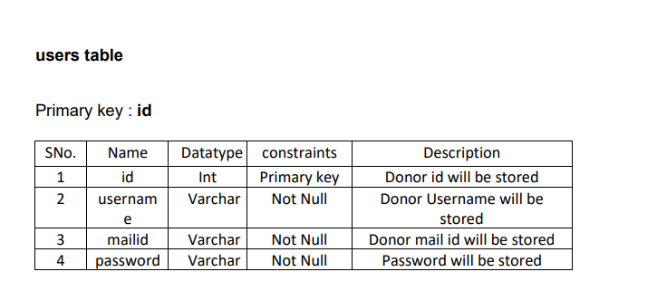
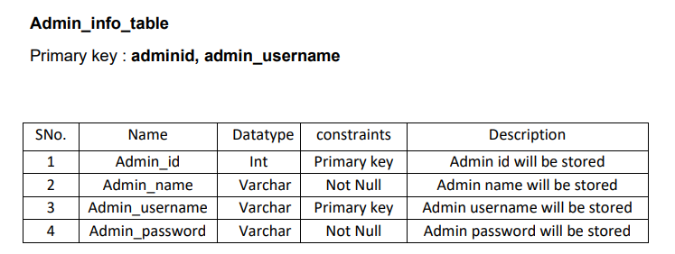
TABLE DESIGN

Slide 24
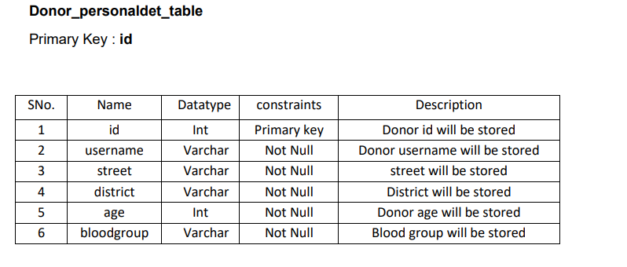
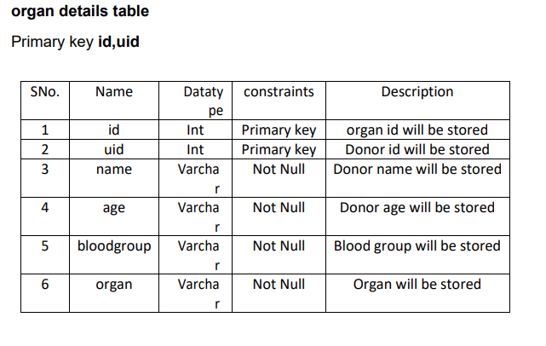

Slide 25
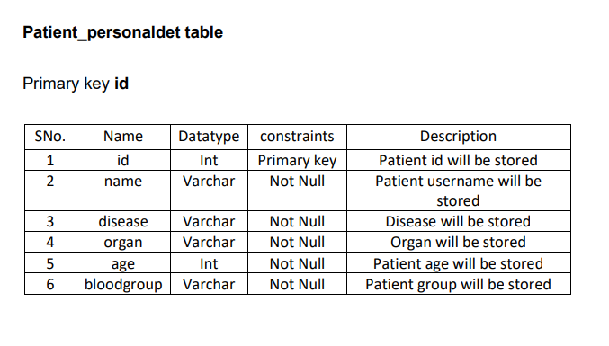
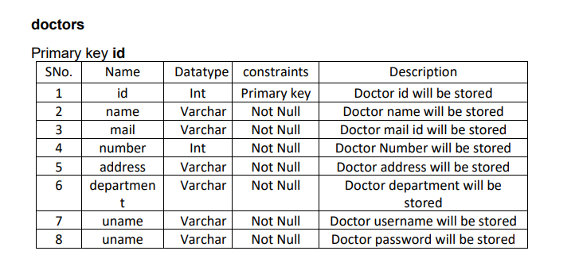

Slide 26
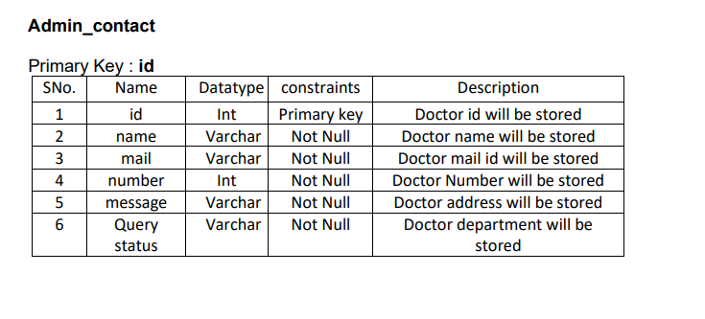

Slide 27
CONCLUSION
This website ORGAN DONATION will be the most user-friendly platform to enroll people in such good activity and will save many lives of the people who are dying due to lack of organ donation. It will create a long-term lifesaving role for every citizen in our state. Our prime target is to provide organs to the seeker when they are in need and make it a life saver platform for those who are dying due to the lack of organs and also targets the human race and spreads the concept of saving life after one’s death.

Slide 28
THANK YOU

